Slide 1
Integrity and Security
Domain Constraints
Referential Integrity
Assertions
Triggers
Security
Authorization
Authorization in SQL

Slide 2
Domain Constraints
Integrity constraints guard against accidental damage to the database, by ensuring that authorized changes to the database do not result in a loss of data consistency.
Domain constraints are the most elementary form of integrity constraint.
They test values inserted in the database, and test queries to ensure that the comparisons make sense.
New domains can be created from existing data types
E.g. create domain Dollars numeric(12, 2) create domain Pounds numeric(12,2)
We cannot assign or compare a value of type Dollars to a value of type Pounds.
However, we can convert type as below (cast r.A as Pounds) (Should also multiply by the dollar-to-pound conversion-rate)

Slide 3
Domain Constraints (Cont.)
The check clause in SQL-92 permits domains to be restricted:
Use check clause to ensure that an hourly-wage domain allows only values greater than a specified value.
create domain hourly-wage numeric(5,2) constraint value-test check(value > = 4.00)
The domain has a constraint that ensures that the hourly-wage is greater than 4.00
The clause constraint value-test is optional; useful to indicate which constraint an update violated.
Can have complex conditions in domain check
create domain AccountType char(10) constraint account-type-test check (value in (‘Checking’, ‘Saving’))
check (branch-name in (select branch-name from branch))

Slide 4
Referential Integrity
Ensures that a value that appears in one relation for a given set of attributes also appears for a certain set of attributes in another relation.
Example: If “Rajshahi” is a branch name appearing in one of the tuples in the account relation, then there exists a tuple in the branch relation for branch “Rajshahi”.
Formal Definition
Let r₁(R₁) and r₂(R₂) be relations with primary keys K₁ and K₂ respectively.
The subset α of R₂ is a foreign key referencing K₁ in relation r₁, if for every t₂ in r₂ there must be a tuple t₁ in r₁ such that t₁[K₁] = t₂[α].
Referential integrity constraint also called subset dependency since its can be written as ∏_{α} (r₂) ⊆ ∏_{K1} (r₁)

Slide 5
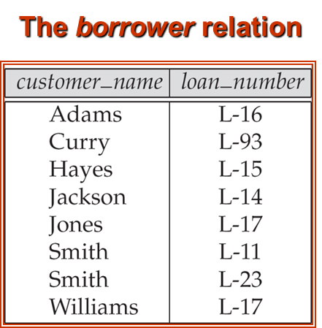
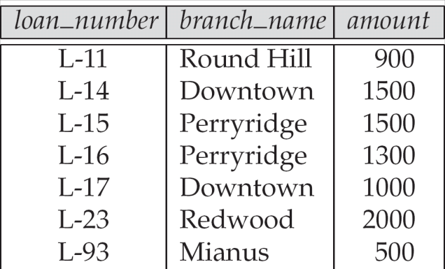
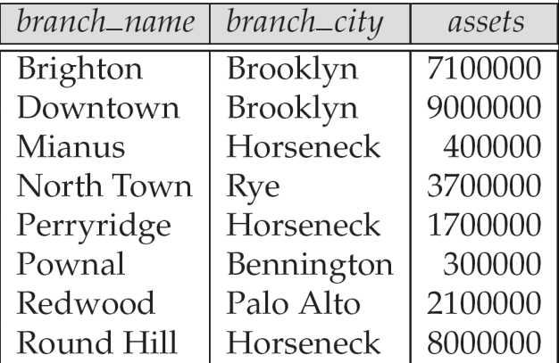
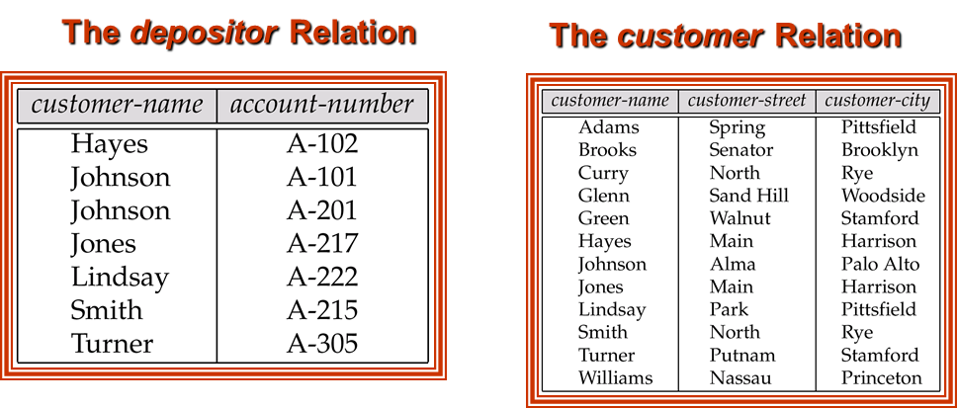
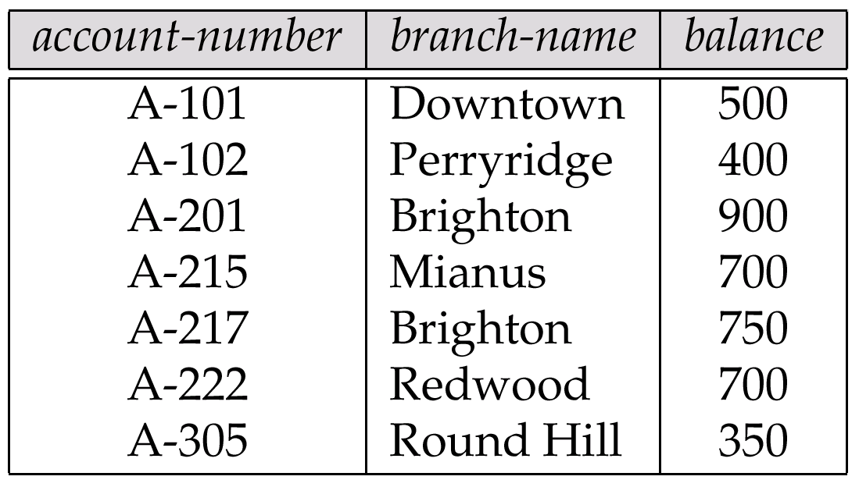
Query:
Find the names of all branches with customers who have an account in the bank and who live in Harrison.
The loan relation
The branch relation
The account relation

Slide 6
Referential Integrity in the E-R Model
Consider relationship set R between entity sets E₁ and E₂. The relational schema for R includes the primary keys K₁ of E₁ and K₂ of E₂. Then K₁ and K₂ form foreign keys on the relational schemas for E₁ and E₂ respectively.
Weak entity sets are also a source of referential integrity constraints. For the relation schema for a weak entity set must include the primary key of the entity set on which it depends.
E1
R
E2

Slide 7
Checking Referential Integrity on Database Modification
The following tests must be made in order to preserve the following referential integrity constraint:
∏_{α} (r₂) ⊆ ∏_{K} (r₁)
Insert. If a tuple t₂ is inserted into r₂, the system must ensure that there is a tuple t₁ in r₁ such that t₁[K] = t₂[α]. That is
t₂ [α] ∈ ∏_{K} (r₁)
Delete. If a tuple, t₁ is deleted from r₁, the system must compute the set of tuples in r₂ that reference t₁:
σ_{α = t1[K]} (r₂)
If this set is not empty, either the delete command is rejected as an error, or the tuples that reference t₁ must themselves be deleted (cascading deletions are possible).

Slide 8
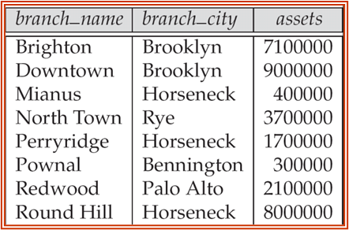
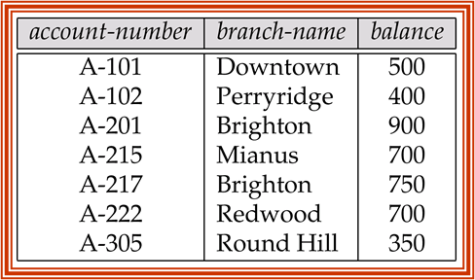
Checking Referential Integrity on Database Modification
The following tests must be made in order to preserve the following referential integrity constraint:
∏_{α} (r₂) ⊆ ∏_{K} (r₁)
Insert. If a tuple t₂ is inserted into r₂, the system must ensure that there is a tuple t₁ in r₁ such that t₁[K] = t₂[α]. That is
t₂ [α] ∈ ∏_{K} (r₁)

Slide 9
Checking Referential Integrity on Database Modification
The following tests must be made in order to preserve the following referential integrity constraint:
∏_{α} (r₂) ⊆ ∏_{K} (r₁)
Insert. If a tuple t₂ is inserted into r₂, the system must ensure that there is a tuple t₁ in r₁ such that t₁[K] = t₂[α]. That is
t₂ [α] ∈ ∏_{K} (r₁)

Slide 10
Database Modification (Cont.)
Update. There are two cases:
If a tuple t₂ is updated in relation r₂ and the update modifies values for foreign key α, then a test similar to the insert case is made. Let t₂’ denote the new value of tuple t₂. The system must ensure that
t₂’[α] ∈ ∏_{K}(r₁)
If a tuple t₁ is updated in r₁, and the update modifies values for the primary key (K), then a test similar to the delete case is made. The system must compute
σ_{α = t1[K]} (r₂)
using the old value of t₁ (the value before the update is applied). If this set is not empty, the update may be rejected as an error, or the update may be cascaded to the tuples in the set, or the tuples in the set may be deleted.

Slide 11
Referential Integrity in SQL
Primary and candidate keys and foreign keys can be specified as part of the SQL create table statement:
The primary key clause of the create table statement includes a list of the attributes that comprise the primary key.
The unique key clause of the create table statement includes a list of the attributes that comprise a candidate key.
The foreign key clause of the create table statement includes both a list of the attributes that comprise the foreign key and the name of the relation referenced by the foreign key.

Slide 12
Referential Integrity in SQL – Example
create table customer (customer-name char(20), customer-street char(30), customer-city char(30), primary key (customer-name))
create table branch (branch-name char(15), branch-city char(30), assets integer, primary key (branch-name))

Slide 13
Referential Integrity in SQL – Example (Cont.)
create table account (account-number char(10), branch-name char(15), balance integer, primary key (account-number), foreign key (branch-name) references branch)
create table depositor (customer-name char(20), account-number char(10), primary key (customer-name, account-number), foreign key (account-number) references account, foreign key (customer-name) references customer)

Slide 14
Cascading Actions in SQL
create table account
. . . foreign key(branch-name) references branch on delete cascade on update cascade . . . )
Due to the on delete cascade clauses, if a delete of a tuple in branch results in referential-integrity constraint violation, the delete “cascades” to the account relation, deleting the tuple that refers to the branch that was deleted.
Cascading updates are similar.

Slide 15
Cascading Actions in SQL (Cont.)
If there is a chain of foreign-key dependencies across multiple relations, with on delete cascade specified for each dependency, a deletion or update at one end of the chain can propagate across the entire chain.
If a cascading update to delete causes a constraint violation that cannot be handled by a further cascading operation, the system aborts the transaction. As a result, all the changes caused by the transaction and its cascading actions are undone.
Referential integrity is only checked at the end of a transaction
Intermediate steps are allowed to violate referential integrity provided later steps remove the violation
Otherwise it would be impossible to create some database states, e.g. insert two tuples whose foreign keys point to each other (e.g. spouse attribute of relation marriedperson)

Slide 16
Referential Integrity in SQL (Cont.)
Alternative to cascading:
on delete set null
on delete set default
Null values in foreign key attributes complicate SQL referential integrity semantics, and are best prevented using not null
if any attribute of a foreign key is null, the tuple is defined to satisfy the foreign key constraint!

Slide 17
Assertions
An assertion is a predicate expressing a condition that we wish the database always to satisfy.
An assertion in SQL takes the form
create assertion <assertion-name> check <predicate>
CREATE ASSERTION salary_assertion.
CHECK (salary <= 100000);

Slide 18
Assertions
An assertion is a predicate expressing a condition that we wish the database always to satisfy.
An assertion in SQL takes the form
create assertion <assertion-name> check <predicate>
When an assertion is made, the system tests it for validity, and tests it again on every update that may violate the assertion
This testing may introduce a significant amount of overhead; hence assertions should be used with great care.
Asserting for all X, P(X) is achieved in a round-about fashion using not exists X such that not P(X)
CREATE ASSERTION salary_assertion. CHECK (salary <= 100000);

Slide 19
Assertion Example
The sum of all loan amounts for each branch must be less than the sum of all account balances at the branch.
create assertion sum-constraint check (not exists (select * from branch where (select sum(amount) from loan where loan.branch-name = branch.branch-name) >= (select sum(amount) from account where loan.branch-name = branch.branch-name)))

Slide 20
Assertion Example
Every loan has at least one borrower who maintains an account with a minimum balance or $1000.00
create assertion balance-constraint check (not exists ( select * from loan where not exists ( select * from borrower, depositor, account where loan loan-number = borrower loan-number and borrower customer-name = depositor customer-name and depositor account-number = account.account-number and account balance >= 1000)))

Slide 21
Triggers
A trigger is a statement that is executed automatically by the system as a side effect of a modification to the database.
To design a trigger mechanism, we must:
Specify the conditions under which the trigger is to be executed.
Specify the actions to be taken when the trigger executes.
Triggers introduced to SQL standard in SQL:1999, but supported even earlier using non-standard syntax by most databases.

Slide 22
Trigger Example
Suppose that instead of allowing negative account balances, the bank deals with overdrafts by
setting the account balance to zero
creating a loan in the amount of the overdraft
giving this loan a loan number identical to the account number of the overdrawn account
The condition for executing the trigger is an update to the account relation that results in a negative balance value.

Slide 23
Trigger Example in SQL:1999
create trigger overdraft-trigger after update on account referencing new row as nrow for each row when nrow.balance < 0 begin atomic insert into borrower (select customer-name, account-number from depositor where nrow.account-number = depositor.account-number); insert into loan values (nrow.account-number, nrow.branch-name, – nrow.balance); update account set balance = 0 where account.account-number = nrow.account-number end

Slide 24
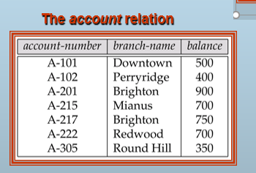
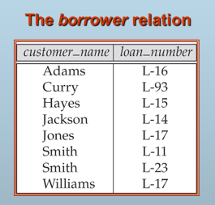
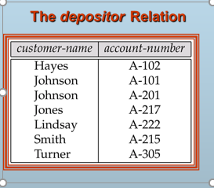
when nrow.balance < 0 begin atomic insert into borrower (select customer-name, account-number from depositor where nrow.account-number = depositor.account-number); insert into loan values (n.row.account-number, nrow.branch-name, – nrow.balance); update account set balance = 0 where account.account-number = nrow.account-number end

Slide 25
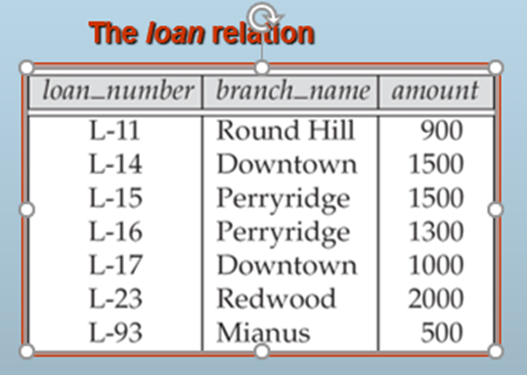
when nrow.balance < 0 begin atomic insert into borrower (select customer-name, account-number from depositor where nrow.account-number = depositor.account-number); insert into loan values (n.row.account-number, nrow.branch-name, – nrow.balance); update account set balance = 0 where account.account-number = nrow.account-number end

Slide 26
when nrow.balance < 0 begin atomic insert into borrower (select customer-name, account-number from depositor where nrow.account-number = depositor.account-number); insert into loan values (n.row.account-number, nrow.branch-name, – nrow.balance); update account set balance = 0 where account.account-number = nrow.account-number end

Slide 27
CREATE TABLE test1(
a1 INT(32)
);
CREATE TABLE test2(
a2 INT(32)
);
https://dev.mysql.com/doc/refman/8.0/en/trigger-syntax.html

Slide 28
CREATE TABLE test3(
a3 INT(32) NOT NULL AUTO_INCREMENT PRIMARY KEY
);
INSERT INTO test3 (a3) VALUES
(0),(0),(0),(0),(0),
(0),(0),(0),(0),(0);
SELECT * FROM test3;
https://dev.mysql.com/doc/refman/8.0/en/trigger-syntax.html

Slide 29

CREATE TABLE test3(
a3 INT(32) NOT NULL AUTO_INCREMENT PRIMARY KEY
);
INSERT INTO test3 (a3) VALUES
(0),(0),(0),(0),(0),
(0),(0),(0),(0),(0);
SELECT * FROM test3;
https://dev.mysql.com/doc/refman/8.0/en/trigger-syntax.html

Slide 30

CREATE TABLE test4(
a4 INT NOT NULL AUTO_INCREMENT PRIMARY KEY,
b4 INT DEFAULT 0
);
INSERT INTO test4 (a4) VALUES
(0), (0), (0), (0), (0), (0), (0), (0), (0), (0)
SELECT * FROM test4;
https://dev.mysql.com/doc/refman/8.0/en/trigger-syntax.html

Slide 31
CREATE TABLE test4(
a4 INT NOT NULL AUTO_INCREMENT PRIMARY KEY,
b4 INT DEFAULT 0
);
INSERT INTO test4 (a4) VALUES
(0), (0), (0), (0), (0), (0), (0), (0), (0), (0)
SELECT * FROM test4;
https://dev.mysql.com/doc/refman/8.0/en/trigger-syntax.html

Slide 32
delimiter |
CREATE TRIGGER testref BEFORE INSERT ON test1
FOR EACH ROW
BEGIN
INSERT INTO test2 SET a2 = NEW.a1;
DELETE FROM test3 WHERE a3 = NEW.a1;
UPDATE test4 SET b4 = b4 + 1 WHERE a4 = NEW.a1;
END;
|
delimiter ;
https://dev.mysql.com/doc/refman/8.0/en/trigger-syntax.html

Slide 33
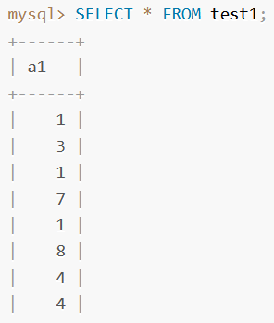
CREATE TABLE test1(
a1 INT(32)
);
INSERT INTO test1 VALUES
(1), (3), (1), (7), (1), (8), (4), (4);
https://dev.mysql.com/doc/refman/8.0/en/trigger-syntax.html

Slide 34
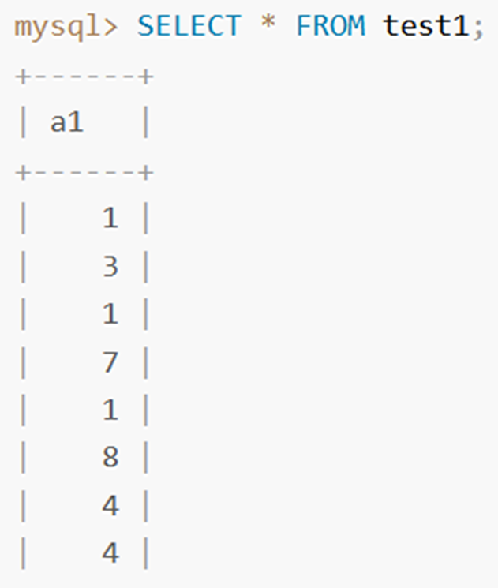
delimiter |
CREATE TRIGGER testref BEFORE INSERT ON test1
FOR EACH ROW
BEGIN
INSERT INTO test2 SET a2 = NEW.a1;
DELETE FROM test3 WHERE a3 = NEW.a1;
UPDATE test4 SET b4 = b4 + 1 WHERE a4 = NEW.a1;
END;
|
delimiter ;

Slide 35
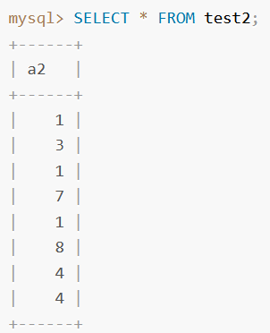
delimiter |
CREATE TRIGGER testref BEFORE INSERT ON test1
FOR EACH ROW
BEGIN
INSERT INTO test2 SET a2 = NEW.a1;
DELETE FROM test3 WHERE a3 = NEW.a1;
UPDATE test4 SET b4 = b4 + 1 WHERE a4 = NEW.a1;
END;
|
delimiter ;

Slide 36

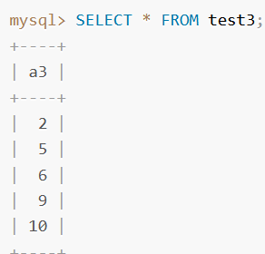
delimiter |
CREATE TRIGGER testref BEFORE INSERT ON test1
FOR EACH ROW
BEGIN
INSERT INTO test2 SET a2 = NEW.a1;
DELETE FROM test3 WHERE a3 = NEW.a1;
UPDATE test4 SET b4 = b4 + 1 WHERE a4 = NEW.a1;
END;
|
delimiter ;

Slide 37
delimiter |
CREATE TRIGGER testref BEFORE INSERT ON test1
FOR EACH ROW
BEGIN
INSERT INTO test2 SET a2 = NEW.a1;
DELETE FROM test3 WHERE a3 = NEW.a1;
UPDATE test4 SET b4 = b4 + 1 WHERE a4 = NEW.a1;
END;
|
delimiter ;

Slide 38
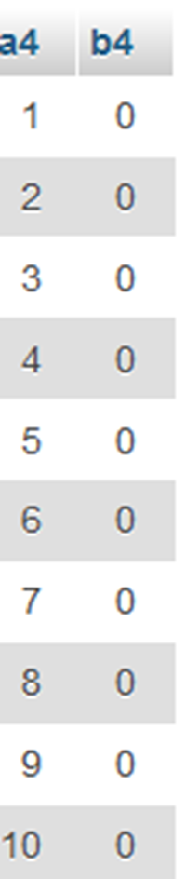
delimiter |
CREATE TRIGGER testref BEFORE INSERT ON test1
FOR EACH ROW
BEGIN
INSERT INTO test2 SET a2 = NEW.a1;
DELETE FROM test3 WHERE a3 = NEW.a1;
UPDATE test4 SET b4 = b4 + 1 WHERE a4 = NEW.a1;
END;
|
delimiter ;

Slide 39
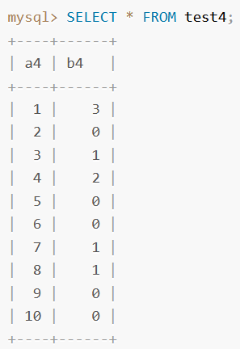
delimiter |
CREATE TRIGGER testref BEFORE INSERT ON test1
FOR EACH ROW
BEGIN
INSERT INTO test2 SET a2 = NEW.a1;
DELETE FROM test3 WHERE a3 = NEW.a1;
UPDATE test4 SET b4 = b4 + 1 WHERE a4 = NEW.a1;
END;
|
delimiter ;

Slide 40
Triggering Events and Actions in SQL
Triggering event can be insert, delete or update
Triggers on update can be restricted to specific attributes
E.g. create trigger overdraft-trigger after update of balance on account
Values of attributes before and after an update can be referenced
referencing old row as : for deletes and updates
referencing new row as : for inserts and updates
Triggers can be activated before an event, which can serve as extra constraints. E.g. convert blanks to null.
create trigger setnull-trigger before update on r referencing new row as nrow for each row when nrow.phone-number = ‘ ‘ set nrow.phone-number = null

Slide 41
delimiter //
CREATE TRIGGER person_bd BEFORE DELETE
ON person
FOR EACH ROW
INSERT INTO person_archive (name, age)
VALUES (OLD.name, OLD.age); //
delimiter ;
https://phoenixnap.com/kb/mysql-trigger

Slide 42
Statement Level Triggers
Instead of executing a separate action for each affected row, a single action can be executed for all rows affected by a single transaction
Use for each statement instead of for each row
Use referencing old table or referencing new table to refer to temporary tables containing the affected rows
Can be more efficient when dealing with SQL statements that update a large number of rows

Slide 43
External World Actions
We sometimes require external world actions, such as re-ordering an item whose quantity in a warehouse has become small, or turning on an alarm light, to be triggered on a database update
Triggers cannot be used to directly implement external-world actions, BUT
Triggers can be used to record actions-to-be-taken in a separate table, and we can have an external process that repeatedly scans the table and carries out external-world actions.
E.g. Suppose a warehouse has the following tables
inventory(item, level): How much of each item is in the warehouse
minlevel(item, level) : What is the minimum desired level of each item
reorder(item, amount): What quantity should we re-order at a time
orders(item, amount) : Orders to be placed (read by external process)

Slide 44
When Not To Use Triggers
Triggers were used earlier for tasks such as
maintaining summary data (e.g. total salary of each department)
Replicating databases by recording changes to special relations (called change or delta relations) and having a separate process that applies the changes over to a replica
There are better ways of doing these now:
Databases today provide built in materialized view facilities to maintain summary data
Databases provide built-in support for replication
Encapsulation facilities can be used instead of triggers in many cases
Define methods to update fields
Carry out actions as part of the update methods instead of through a trigger

Slide 45
Security
Security - protection from malicious attempts to steal or modify data.
Database system level
Authentication and authorization mechanisms to allow specific users access only to required data
We concentrate on authorization in the rest of this chapter
Operating system level
Operating system super-users can do anything they want to the database! Good operating system level security is required.
Network level: must use encryption to prevent
Eavesdropping (unauthorized reading of messages)

Slide 46
Security (Cont.)
Physical level
Physical access to computers allows destruction of data by intruders; traditional lock-and-key security is needed
Computers must also be protected from floods, fire, etc.
More in Chapter 17 (Recovery)
Human level
Users must be screened to ensure that an authorized users do not give access to intruders
Users should be trained on password selection and secrecy
Password Guideline:
https://learn.microsoft.com/en-us/microsoft-365/admin/misc/password-policy-recommendations?view=o365-worldwide

Slide 47
Authorization
Forms of authorization on parts of the database:
Read authorization - allows reading, but not modification of data.
Insert authorization - allows insertion of new data, but not modification of existing data.
Update authorization - allows modification, but not deletion of data.
Delete authorization - allows deletion of data

Slide 48
Authorization (Cont.)
Forms of authorization to modify the database schema:
Index authorization - allows creation and deletion of indices.
Resources authorization - allows creation of new relations.
Alteration authorization - allows addition or deletion of attributes in a relation.
Drop authorization - allows deletion of relations.

Slide 49
Authorization and Views
Users can be given authorization on views, without being given any authorization on the relations used in the view definition
Ability of views to hide data serves both to simplify usage of the system and to enhance security by allowing users access only to data they need for their job
A combination or relational-level security and view-level security can be used to limit a user’s access to precisely the data that user needs.

Slide 50
View Example
Suppose a bank clerk needs to know the names of the customers of each branch, but is not authorized to see specific loan information.
Approach: Deny direct access to the loan relation, but grant access to the view cust-loan, which consists only of the names of customers and the branches at which they have a loan.
The cust-loan view is defined in SQL as follows:
create view cust-loan as select branchname, customer-name from borrower, loan where borrower.loan-number = loan.loan-number

Slide 51
View Example (Cont.)
The clerk is authorized to see the result of the query:
select * from cust-loan
When the query processor translates the result into a query on the actual relations in the database, we obtain a query on borrower and loan.
Authorization must be checked on the clerk’s query before query processing begins.

Slide 52
Authorization on Views
Creation of view does not require resources authorization since no real relation is being created
The creator of a view gets only those privileges that provide no additional authorization beyond that he already had.
E.g. if creator of view cust-loan had only read authorization on borrower and loan, he gets only read authorization on cust-loan

Slide 53
Granting of Privileges
U₁
U₄
DBA
U₂
U₅
U₃
The passage of authorization from one user to another may be represented by an authorization graph.
The nodes of this graph are the users.
The root of the graph is the database administrator.
Consider graph for update authorization on loan.
An edge U_{i} →U_{j} indicates that user U_{i} has granted update authorization on loan to U_{j.}

Slide 54
Authorization Grant Graph
Requirement: All edges in an authorization graph must be part of some path originating with the database administrator
If DBA revokes grant from U₁:
Grant must be revoked from U₄ since U₁ no longer has authorization
Grant must not be revoked from U₅ since U₅ has another authorization path from DBA through U₂
Must prevent cycles of grants with no path from the root:
DBA grants authorization to U₇
U7 grants authorization to U₈
U8 grants authorization to U₇
DBA revokes authorization from U₇
Must revoke grant U₇ to U₈ and from U₈ to U₇ since there is no path from DBA to U₇ or to U₈ anymore.

Slide 55
Security Specification in SQL
The grant statement is used to confer authorization
grant <privilege list>
on <relation name or view name> to <user list>
<user list> is:
a user-id
public, which allows all valid users the privilege granted
A role (more on this later)
Granting a privilege on a view does not imply granting any privileges on the underlying relations.
The grantor of the privilege must already hold the privilege on the specified item (or be the database administrator).

Slide 56
Privileges in SQL
select: allows read access to relation,or the ability to query using the view
Example: grant users U₁, U₂, and U₃ select authorization on the branch relation:
grant select on branch to U₁, U₂, U₃
insert: the ability to insert tuples
update: the ability to update using the SQL update statement
delete: the ability to delete tuples.
references: ability to declare foreign keys when creating relations.
usage: In SQL-92; authorizes a user to use a specified domain
all privileges: used as a short form for all the allowable privileges

Slide 57
MariaDB [(none)]> CREATE USER u1@localhost IDENTIFIED BY '1234';
Query OK, 0 rows affected (0.002 sec)
MariaDB [(none)]> CREATE USER u2@localhost IDENTIFIED BY '1234';
Query OK, 0 rows affected (0.002 sec)
MariaDB [(none)]> CREATE USER 'u4'@'localhost' WITH
MAX_USER_CONNECTIONS 10
MAX_QUERIES_PER_HOUR 200;
Query OK, 0 rows affected (0.004 sec)
MariaDB [(none)]> CREATE USER 'u3'@'localhost' PASSWORD EXPIRE;
Query OK, 0 rows affected (0.003 sec)

Slide 58
MariaDB [(none)]> GRANT ALL PRIVILEGES ON *.* to 'u1'@'localhost'
-> WITH GRANT OPTION;
Query OK, 0 rows affected (0.002 sec)
MariaDB [(none)]> GRANT INSERT on temp.* TO 'u2'@'localhost';
Query OK, 0 rows affected (0.005 sec)
MariaDB [(none)]> GRANT INSERT on temp.branch TO 'u3'@'localhost';
Query OK, 0 rows affected (0.004 sec)

Slide 59
MariaDB [(none)]> SET PASSWORD FOR 'u3'@'localhost’ = PASSWORD('1234');
Query OK, 0 rows affected (0.003 sec)
MariaDB [temp]> select * from loan;
ERROR 1142 (42000): SELECT command denied to user 'u3'@'localhost' for table 'loan'
MariaDB [temp]> insert into loan values ('L-60','Downtown','2500');
ERROR 1142 (42000): INSERT command denied to user 'u3'@'localhost' for table 'loan'
MariaDB [temp]> insert into branch values ('Central','Westminster','70500');
Query OK, 1 row affected (0.005 sec)

Slide 60
Privilege To Grant Privileges
with grant option: allows a user who is granted a privilege to pass the privilege on to other users.
Example:
grant select on branch to U₁ with grant option
gives U₁ the select privileges on branch and allows U₁ to grant this
privilege to others

Slide 61
Roles
Roles permit common privileges for a class of users can be specified just once by creating a corresponding “role”
Privileges can be granted to or revoked from roles, just like user
Roles can be assigned to users, and even to other roles
SQL:1999 supports roles
create role teller create role manager
grant select on branch to teller grant update (balance) on account to teller grant all privileges on account to manager grant teller to manager grant teller to alice, bob grant manager to avi

Slide 62
Revoking Authorization in SQL
The revoke statement is used to revoke authorization.
revoke<privilege list>
on <relation name or view name> from <user list> [restrict|cascade]
Example:
revoke select on branch from U₁, U₂, U₃ cascade
Revocation of a privilege from a user may cause other users also to lose that privilege; referred to as cascading of the revoke.
We can prevent cascading by specifying restrict:
revoke select on branch from U₁, U₂, U₃ restrict
With restrict, the revoke command fails if cascading revokes are required.

Slide 63
Revoking Authorization in SQL (Cont.)
<privilege-list> may be all to revoke all privileges the revokee may hold.
If <revokee-list> includes public all users lose the privilege except those granted it explicitly.
If the same privilege was granted twice to the same user by different grantees, the user may retain the privilege after the revocation.
All privileges that depend on the privilege being revoked are also revoked.

Slide 64
Limitations of SQL Authorization
SQL does not support authorization at a tuple level
E.g. we cannot restrict students to see only (the tuples storing) their own grades
All end-users of an application (such as a web application) may be mapped to a single database user
The task of authorization in above cases falls on the application program, with no support from SQL
Authorization must be done in application code, and may be dispersed all over an application
Checking for absence of authorization loopholes becomes very difficult since it requires reading large amounts of application code

Slide 65
Encryption
Data may be encrypted when database authorization provisions do not offer sufficient protection.
Properties of good encryption technique:
Relatively simple for authorized users to encrypt and decrypt data.
Encryption scheme depends not on the secrecy of the algorithm but on the secrecy of a parameter of the algorithm called the encryption key.
Extremely difficult for an intruder to determine the encryption key.

Slide 66
Encryption (Cont.)
Data Encryption Standard (DES) substitutes characters and rearranges their order on the basis of an encryption key which is provided to authorized users via a secure mechanism. Scheme is no more secure than the key transmission mechanism since the key has to be shared.
Advanced Encryption Standard (AES) is a new standard replacing DES, and is based on the Rijndael algorithm, but is also dependent on shared secret keys
Public-key encryption is based on each user having two keys:
public key – publicly published key used to encrypt data, but cannot be used to decrypt data
private key -- key known only to individual user, and used to decrypt data. Need not be transmitted to the site doing encryption.
Encryption scheme is such that it is impossible or extremely hard to decrypt data given only the public key.
The RSA public-key encryption scheme is based on the hardness of factoring a very large number (100's of digits) into its prime components.

Slide 67
Authentication
Password based authentication is widely used, but is susceptible to sniffing on a network
Challenge-response systems avoid transmission of passwords
DB sends a (randomly generated) challenge string to user
User encrypts string and returns result.
DB verifies identity by decrypting result
Can use public-key encryption system by DB sending a message encrypted using user’s public key, and user decrypting and sending the message back
Digital signatures are used to verify authenticity of data
E.g. use private key (in reverse) to encrypt data, and anyone can verify authenticity by using public key (in reverse) to decrypt data. Only holder of private key could have created the encrypted data.
Digital signatures also help ensure nonrepudiation: sender cannot later claim to have not created the data

Slide 68
End of Chapter

Slide 69
Statistical Databases
Problem: how to ensure privacy of individuals while allowing use of data for statistical purposes (e.g., finding median income, average bank balance etc.)
Solutions:
System rejects any query that involves fewer than some predetermined number of individuals.
∗ Still possible to use results of multiple overlapping queries to deduce data about an individual
Data pollution -- random falsification of data provided in response to a query.
Random modification of the query itself.
There is a tradeoff between accuracy and security.

Slide 70
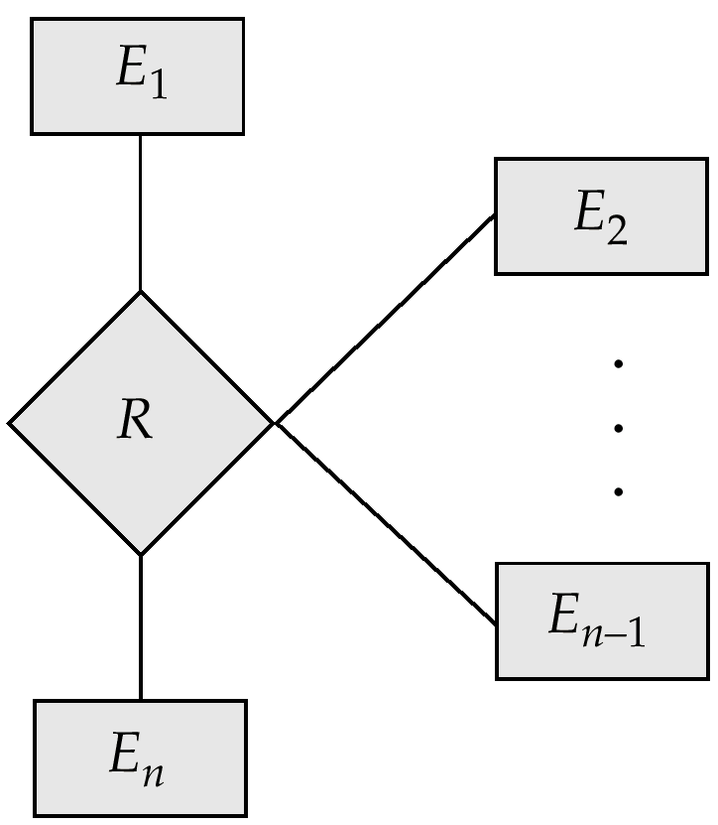
An n-ary Relationship Set

Slide 71
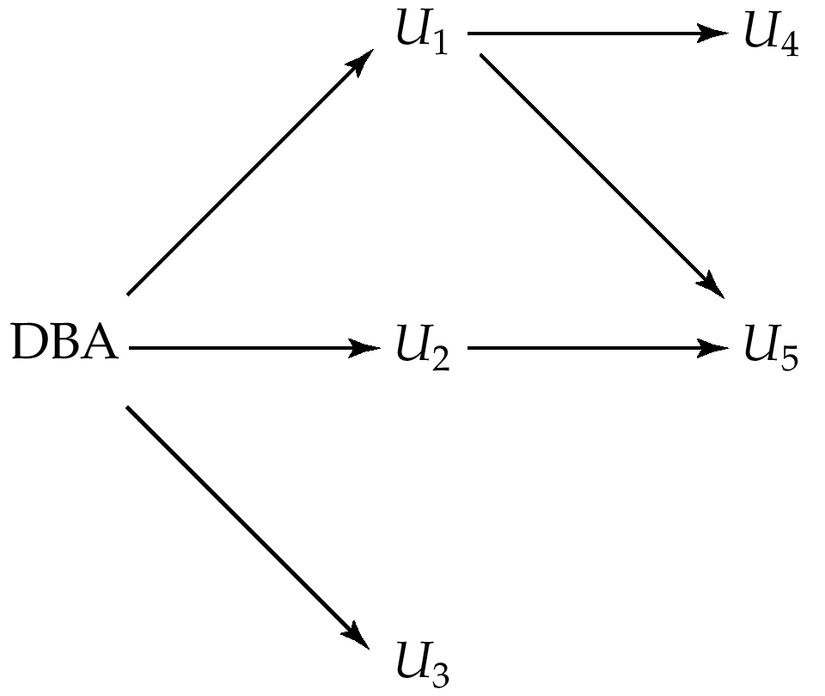
Authorization-Grant Graph

Slide 72
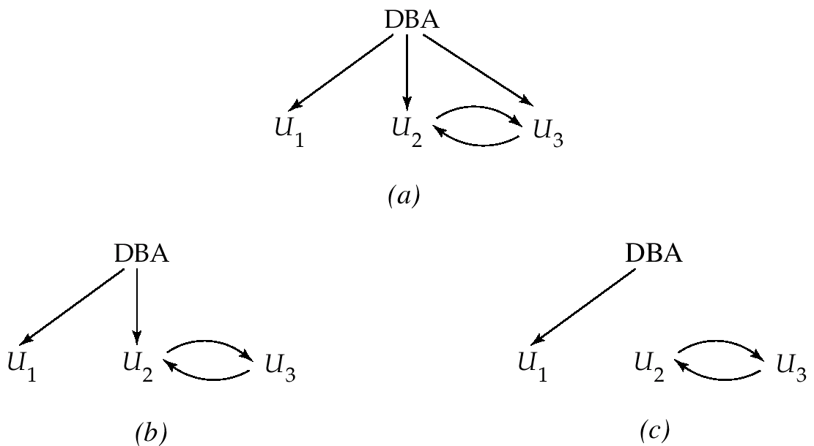
Attempt to Defeat Authorization Revocation

Slide 73
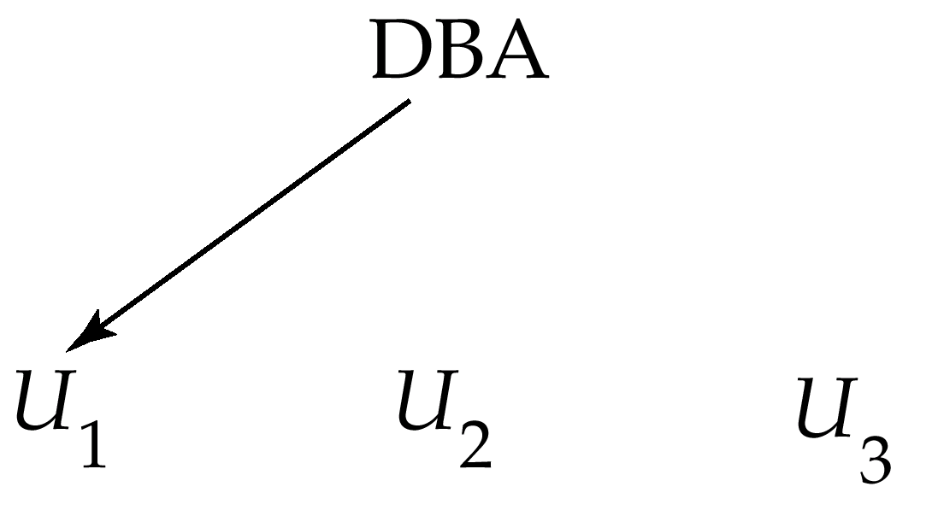
Authorization Graph

Slide 74
Physical Level Security
Protection of equipment from floods, power failure, etc.
Protection of disks from theft, erasure, physical damage, etc.
Protection of network and terminal cables from wiretaps non-invasive electronic eavesdropping, physical damage, etc.
Solutions:
Replicated hardware:
mirrored disks, dual busses, etc.
multiple access paths between every pair of devises
Physical security: locks,police, etc.
Software techniques to detect physical security breaches.

Slide 75
Human Level Security
Protection from stolen passwords, sabotage, etc.
Primarily a management problem:
Frequent change of passwords
Use of “non-guessable” passwords
Log all invalid access attempts
Data audits
Careful hiring practices

Slide 76
Operating System Level Security
Protection from invalid logins
File-level access protection (often not very helpful for database security)
Protection from improper use of “superuser” authority.
Protection from improper use of privileged machine intructions.

Slide 77
Network-Level Security
Each site must ensure that it communicate with trusted sites (not intruders).
Links must be protected from theft or modification of messages
Mechanisms:
Identification protocol (password-based),
Cryptography.

Slide 78
Database-Level Security
Assume security at network, operating system, human, and physical levels.
Database specific issues:
each user may have authority to read only part of the data and to write only part of the data.
User authority may correspond to entire files or relations, but it may also correspond only to parts of files or relations.
Local autonomy suggests site-level authorization control in a distributed database.
Global control suggests centralized control.

